Slide 1
Driving in the Oilfield: a Review of Driving Risk and Safety Practices
Kyla Retzer, MPH
Coordinator, Center for Motor Vehicle Safety
Research Epidemiologist
National Institute for Occupational Safety and Health
Centers for Disease Control and Prevention
Permian Basin Road Safety Coalition
April 2020

Slide 2
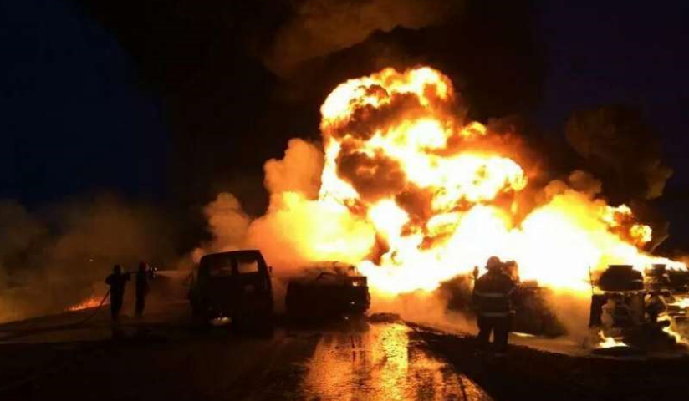
Case Study: Oilfield Crash
A crude oil tanker truck rolled on it’s side in collision with pickup
A van carrying 5 oilfield workers slammed into tanker truck and burst into flames
All five men died, all were Hispanic
Were heading home from work at a wellsite 78 miles from home
Notes:
At 6:30am, in the Eagleford Shale,
“Five men died while commuting to work when their van (vehicle #3) slammed into a crude oil tanker truck and burst into flames on the highway. 4 vehicles were involved in this accident. Pickup truck (vehicle #1) was making a left turn when the tanker truck (Vehicle #2) took evasive action to miss Vehicle #1, lost control and turned over. The tanker remained with its lights off in the dark unlit road. When Vehicle #3 saw it, it was too late and slammed into Vehicle #2, engulfed into flames resulting in the death of 5 of its passengers. The vehicle behind vehicle #3, #4 in this accident, also slammed into the pile up and it too engulfed into flames. The driver of vehicle #4 suffered burns on over 85% of his body.”

Slide 3
Case Study: Significant Factors
Dark, unlit roads
Crude oil cargo tank in road and not visible
Long drive to/from work
Potential fatigue/ distraction
Crash reports did not report any info on seatbelt use, ejection, or other contributing factors
Notes:
Significant Factors as identified in the investigation. Several opportunities for

Slide 4
Topics for today’s presentation
Oil and gas transportation fatalities
Best practices for reducing road risk
Driver Coaching

Slide 5
Rate of fatal work injuries increased in 2017 & 2018
Note: Fatality counts from BLS Census of Fatal Occupational Injuries. Worker Estimates from BLS Quarterly Census of Employment and Wages. Rate per 100,000 workers per year. Includes NAICS 211, 213111, 213112..
N=1,660
Notes:
Large proportion of workers had less than one year of experience with their current employer
Demographics:
All but 10 fatalities were to males (99%)
Largest # of deaths were to workers aged 25-34 (28%)
Most workers were non-Hispanic Whites (71%)
Company type:
The greatest number of deaths occurred to workers employed by well servicing companies (615, 52%), followed by drilling contractors (378, 32%), and operators (196, 16%).
Trends:
Number of deaths increased 28% during this time period
Rate of fatal injuries decreased by 36% overall, but that rate (25/100,00) remains approximately 7 times higher than all US rate

Slide 6
Percent of fatalities from transportation events is increasing in recent years

Slide 7
Drilling Operations NAICS 213111
Causes of fatality by company type, 2018
Support Activities
NAICS 213112
Oil and Gas Operators NAICS 211
Event Type | No. | %
Fires/Explosions | 5 | 36%
Transportation | 4 | 29%
Contact with Objects and Equipment | 3 | 21%
Other | 2 | 14%
TOTAL | 14
Event Type | No. | %
Transportation | 34 | 51%
Contact with Objects and Equipment | 14 | 21%
Fires/Explosions | 7 | 10%
Falls | 6 | 9%
Exposure to Harmful Substances/ Environments | 5 | 7%
Other | 1 | 1%
TOTAL | 67
Event Type | No. | %
Transportation | 10 | 77%
Other | 3 | 23%
TOTAL | 13
Note: Fatality counts from BLS Census of Fatal Occupational Injuries

Slide 8
In 2018, fatalities of large truck occupants dropped and increased for pick-up truck occupants

Slide 9
“Collisions with other vehicle” most frequent crash type (2011–2018)
Note: Fatality counts from BLS Census of Fatal Occupational Injuries

Slide 10
Rate of SEVERE speeding units by hourly interval
Source: Retzer, Kushnir 2018
Notes:
Occurs in the first hour, then begins to occur at a greater rate at the 10th plus hour.

Slide 11
Risk factors for oil and gas motor vehicle fatalities
Fatigue or distraction are involved in at least 1 in 5 fatal crashes
At least 40% of drivers and 60% of occupants not wearing their seatbelt
Speed: 60-70 mph results in a 32% increase in injury crash frequency, a 48% increase in severity, and a 64% increase in fatal crash frequency
Notes:
Nationally,
in 2016, 9% of all traffic fatalities involved driver distraction (claimed at least 3,450 lives);
14% of distracted driving fatalities involved a phone (486 deaths);
cell phone use is highest among 16-24 year olds.
2011-2014:
In OGE, we estimate that fatigue and distraction combined are involved in 1 in 5 fatal crashes
Notes:
Distracted drivers who injures others can be prosecuted, and if their call was work related, then employers are vulnerable to being sued as well.

Slide 12
Best Practices for Reducing Road Risk
Increase seatbelt use
IVMS with driver coaching
Journey Management
Address driver distraction

Slide 13
Increase seatbelt use
Recommendations:
Use IVMS
Conduct seatbelt observations
Conduct seatbelt checks when leaving a wellsite
Resources:
NHTSA 2 Seconds 2 Click
IOGP “Buckle Up! Bust the Myth”
Notes:
Driving Safety is one of IOGP’s 9 Life Saving Rules
IOGP also has a “Land Transportation Safety” Recommended Practice that includes information about IVMS and JM

Slide 14
The best cell phone policies cover…
All work-related communications, even in personal vehicles or on personal cell phones
All employees
All handheld and hands-free devices
All company vehicles
All company mobile phone devices
Source: National Safety Council

Slide 15
Take the Pledge
Make the commitment to drive phone-free today.
Protect lives by never texting or talking on the phone while driving.
Be a good passenger and speak out if the driver in my car is distracted.
Encourage my friends and family to drive phone-free.
Source: NHTSA

Slide 16
In-Vehicle Monitoring Systems (IVMS)
Records Data
Measures Performance
Changes Behavior
`
`
`
Date and Time
Speed
Acceleration/ Deceleration
Seat Belt Use
Measures driver performance against a predetermined set of parameters
Has shown to be effective in realizing immediate and positive effect on driver behavior
Motor Vehicle Crash Rates¹
50–90%
Speeding²
60%
Miles Driven³
8-20%
NIOSH study showed a 52% reduction in safety critical events when IVMS using cameras was implemented with coaching by supervisors.⁴
¹ Gale et. al, 2012, Mora et. al, 2010, Velasquez, et. al, 2010, Matusalen, et. al, 2006, Ballard et. al, 2004, Jutten et. al, 2002, Cocianni & Taviansky, 1998); ² Twilhaar, 2000; ³ Lopez, 2006, Twiilar, 2000., ⁴Bell et. al, 2017.

Slide 17
Implementing IVMS
Pick the right system for your fleet
Set realistic expectations for your equipment and drivers
Conduct driver coaching based on IVMS feedback
Notes:
Pilot test equipment
Expectations for equipment
Next several slides: third bullet

Slide 18
IVMS + Driver Coaching
Notes:
These industry-recommended practices include coaching strategies that can be used in conjunction with in-vehicle monitoring systems (IVMS) to change an organization’s safety culture and improve driver performance.
Mention the draft document and that the coaching strategies described here are not an exhaustive list.

Slide 19
Set feasible goals
Examples of effective goals include:
Zero driving time without buckled seat belt
Fewer than 3 speeding events based on IVMS tracking
Always perform a walk-around the vehicle to ensure it is safe to move it
Notes:
It is important for employees to have a target performance.

Slide 20
Meet regularly
Set weekly or monthly meetings with your employees, and go through each employee’s IVMS report with them.
Notes:
Consider more frequent feedback at a distance through phone/email/text and less frequent meetings in person. In person meetings should be kept brief and to the point. Provide employees with feedback on how they did, what they may need to do better, and allow employees the opportunity to offer explanations and ask questions. It is often as effective to be straightforward about what you do *not* intend to communicate during feedback as it is what you do intend.

Slide 21
Look for patterns of behaviors
Look at IVMS data for patterns of driver behaviors emerge over time. You’ll learn about your employee’s driving habits and can see what behaviors need to be targeted or how their behaviors are impacted over time with a positive safety culture.

Slide 22
Target behaviors, not the driver
Never criticize an individual’s character, instead, target their behaviors if you want to see change.
Notes:
Consider following a behavior-based safety model.

Slide 23
Perform ride- alongs
Ride-alongs provide an opportunity for management to interact in a one-on-one situation with employees and gain insight into their driving styles.
**Not recommended at this time**

Slide 24
Use discretion
With the information the IVMS provides, it is important to provide yourself and your managers the ability to use discretion on how severe violations are handled and how to proceed during coaching.
Notes:
Harsh braking example: leaving distance with vehicle, cut-off, harsh braking to avoid crash
No one data point should be used to make decisions about driver performance

Slide 25
Remind them why safety is important
Sometimes the strongest messages are framed to focus on what is most important, going home safely to family and friends.

Slide 26
Journey Management
Definition: A planned and systematic strategy to reduce transportation-related risks within a companies operations.
Is motor vehicle travel necessary?
Is it the safest method of transport?
Is it the safest route, time of day, vehicle, and driver?
Available at: https://www.energysafetycanada.com/_Resources/Guidelines-Reports/JOURNEY-MANAGEMENT-A-PROGRAM-DEVELOPMENT-GUIDE
Notes:
Objective: minimize unnecessary trips, distances driven and the risks associated with necessary trips.
formal procedure/policy with location specific assessments of hazards and how to minimize hazards (road, weather, traffic, vehicle, driver)
Process to assess need for trips
procedure for managing trips (pre-trip, trip and post-trip procedures)

Slide 27
Free Resources
eDriving seminar: The seven stages of distraction denial
https://www.edriving.com/distracted-driving/
International Assn. of Oil and Gas Producers (IOGP)
https://www.iogp.org/oil-and-gas-safety/land-transport-safety/
Network of Employers for Traffic Safety:
https://driventowellness.org/
Notes:
NSC has now folded their original “Cell Phone Policy Kit” into a larger tool called the Safe Driving Toolkit. You may want to provide this link: https://www.nsc.org/road-safety/tools-resources/safe-driving-kit. It’s free, although you do have to identify yourself.
If you can also provide a link to anything from IOGP, that would be helpful.

Slide 28
Seatbelt Campaign and Materials
National Highway Traffic Safety Administration (NHTSA):
https://2seconds2click.org/
International Oil and Gas Producers (IOGP):
https://www.iogp.org/buckleup/

Slide 29
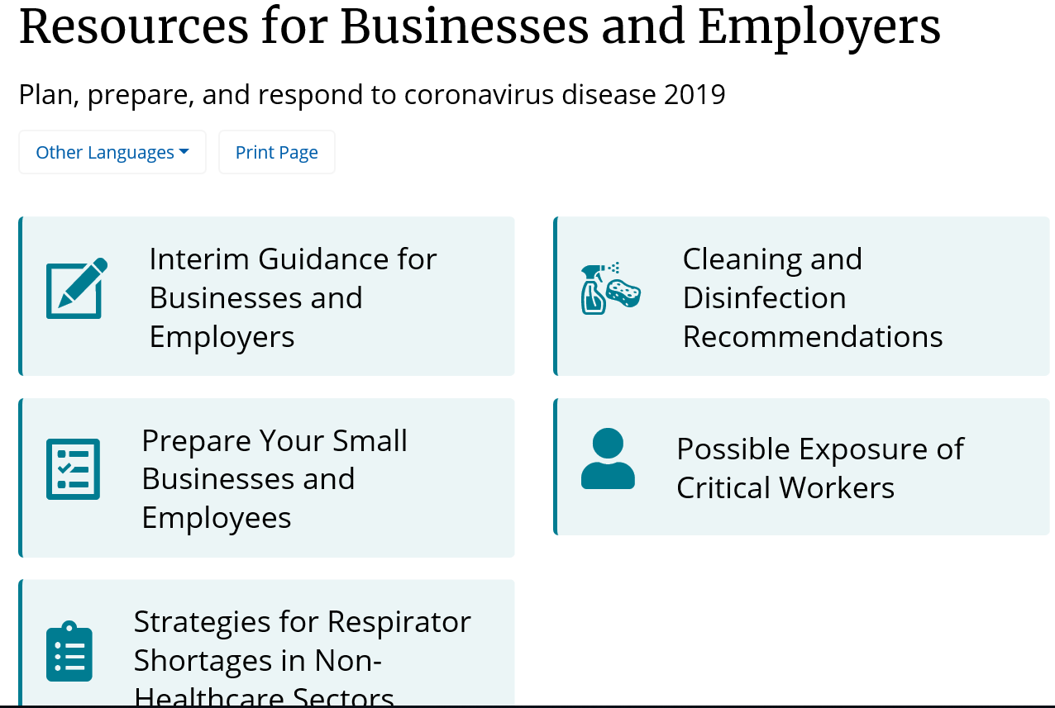
CDC COVID resources for businesses
https://www.cdc.gov/coronavirus/2019-ncov/community/organizations/businesses-employers.html

Slide 30
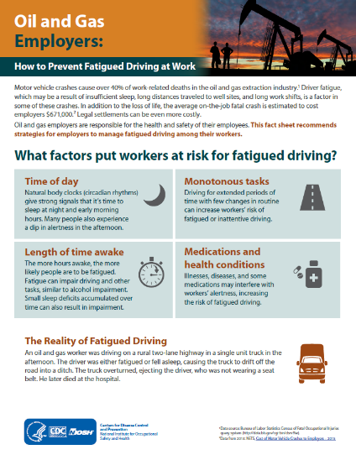
NIOSH fatigue fact sheets for oil & gas
For workers
For employers
https://www.cdc.gov/niosh/docs/2018-126/default.html
https://www.cdc.gov/niosh/docs/2018-125/default.html

Slide 31
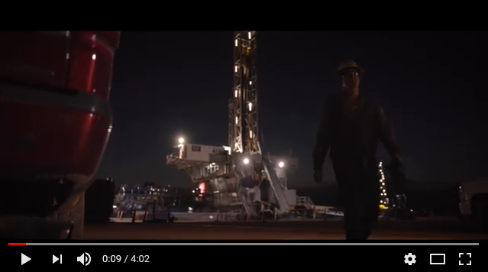
Helmerich & Payne: Drive Safe Video
https://www.youtube.com/watch?v=x3OgZjVd0JQ&feature=youtu.be

Slide 32
Questions?
Kyla Retzer, MPH
Coordinator
NIOSH Center for Motor Vehicle Safety
303.236.5934
kretzer@cdc.gov
The findings and conclusions in this presentation are those of the author and do not necessarily represent the official position of the National Institute for Occupational Safety and Health, Centers for Disease Control and Prevention.

