Slide 1
PERMIAN BASIN HIGH SCHOOL ROAD SAFETY PROGRAM

Slide 2
Distracted driving is
an epidemic.
9 people a DAY die + 390,000 are injured every year in America from crashes caused by texting and driving.
You are 23x more likely to crash when texting and driving
89% of people say no one should text and drive but they believe they are an exception and can multi-task well.

Slide 3
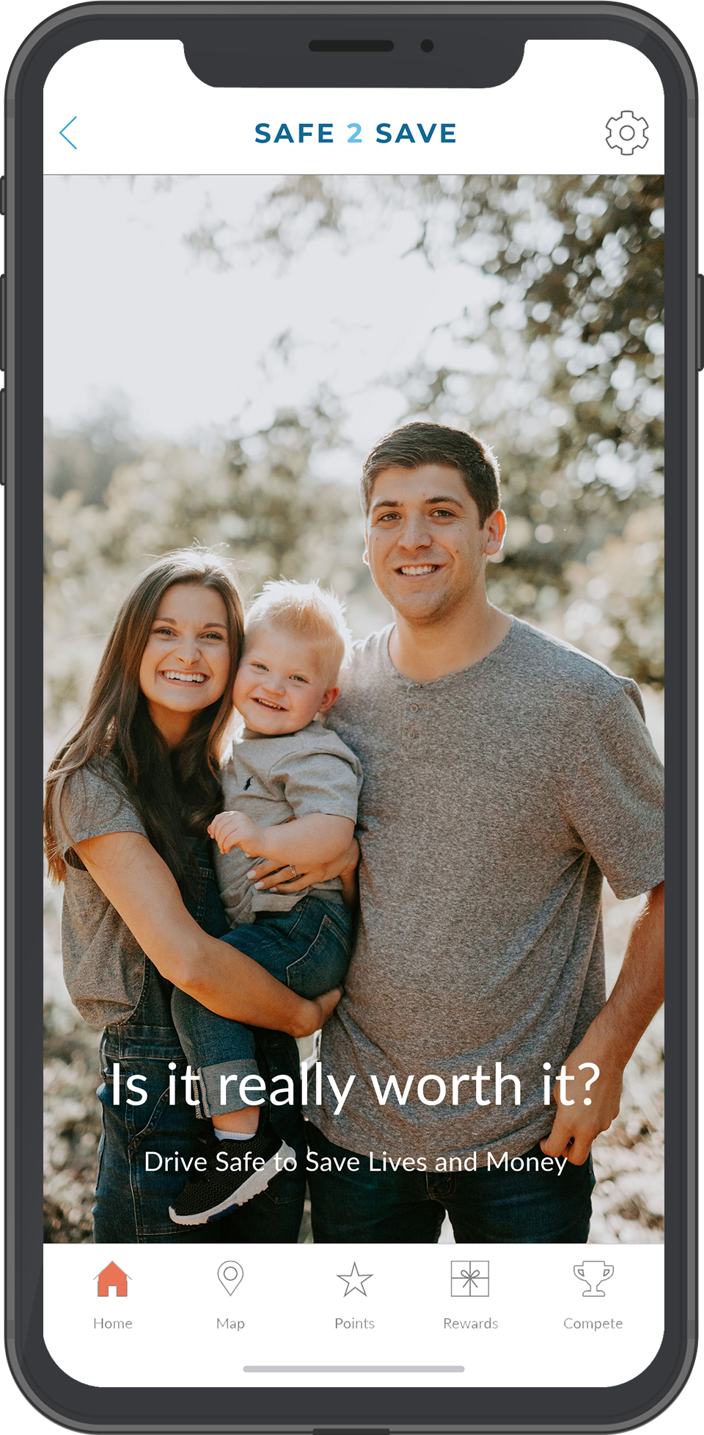
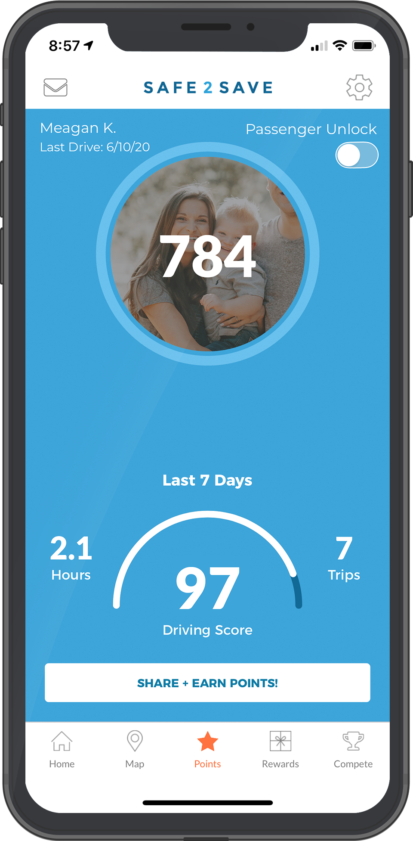
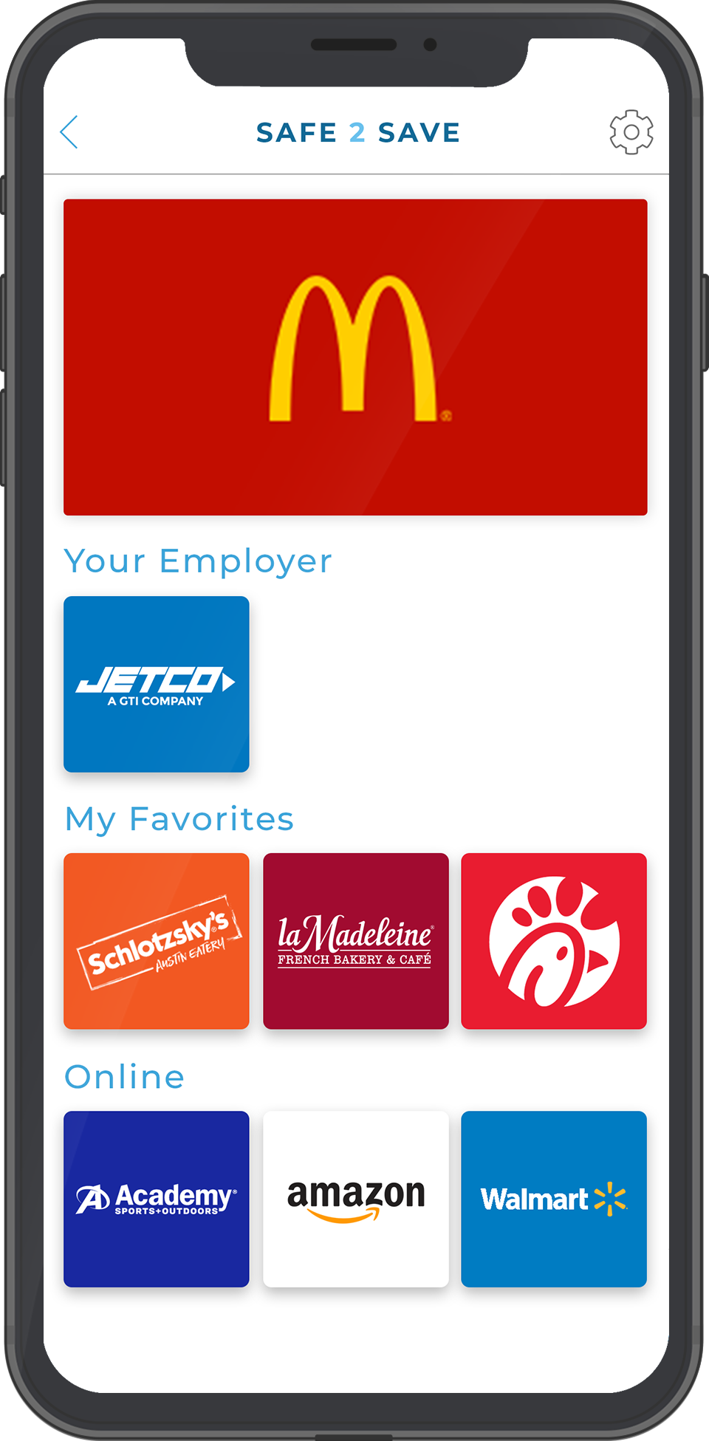
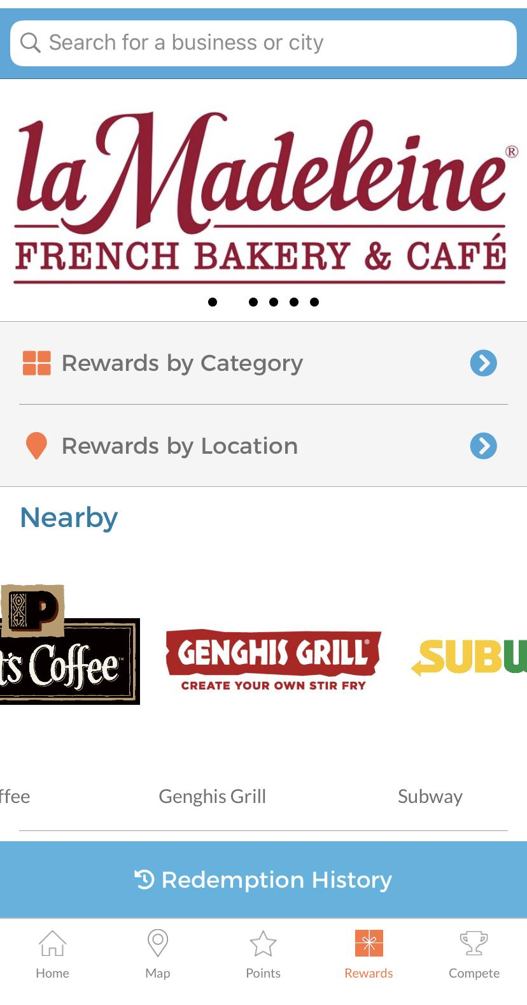
Technology Can Help Solve This!
Open the App
Earn Points as You Drive
Redeem at Businesses
A picture of loved ones reminds you that distracted driving is not worth it.
Get rewarded points for undistracted driving 10 mph or more.
Easily redeem your points at over 1,500 restaurants & businesses you love.

Slide 4
Notes:
JUST AN IMAGE

Slide 5
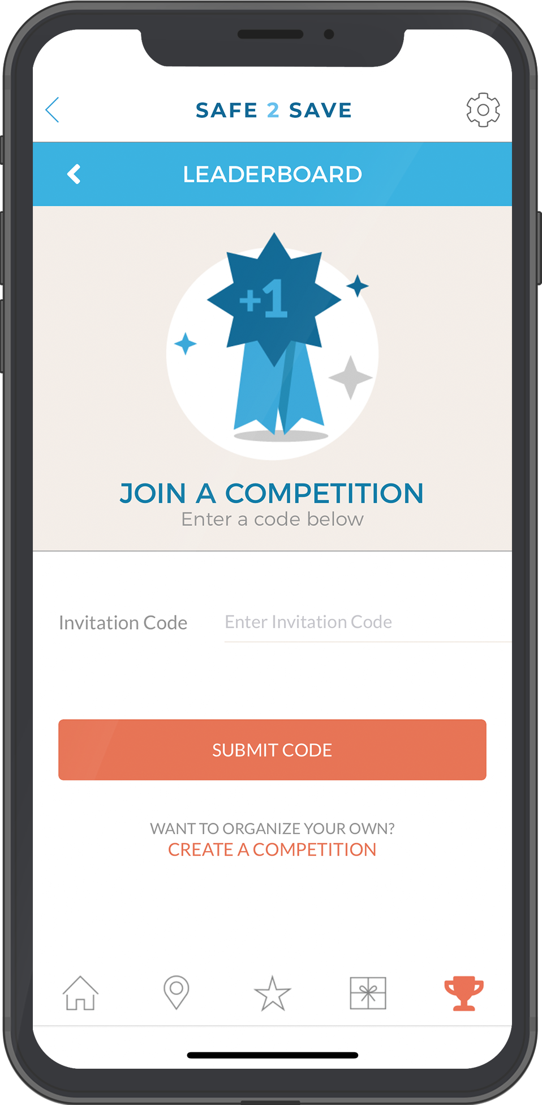
High School Competition
January 29th - March 29th
1/29 - 3/29
We are excited for you to participate in the Arrive Alive High School Competition.
$27,000 will be given away to students, parents and high school teachers!
http://safe2save.org/arrivealivepb

Slide 6
Prizes YOU Can Win
$27,000 of Prizes!!
Overall Competition Prizes – Group A + Group B We will be breaking the seven schools up into two groups, based on the size of the high schools GROUP 1 = Lee, Midland High, Permian and Odessa High School GROUP 2 = Kermit High School, Andrews High School, Monahans High School, Pecos High School, Wink High School
Overall Individual School Prizes We will be awarding the following prizes to ALL of the participating high schools at the end of the competition. $150 Visa Gift Card for Student with Best Score per School $150 Visa Gift Card for Teacher with Best Score per School
Weekly Individual School Prizes We will be awarding the following prizes to ALL of the participating high schools each week of the competition. $75 Visa Gift Card to Student with Best Weekly Score per School $75 Visa Gift Card to Parent with Best Weekly Score per School $75 Visa Gift Card to Teacher with Best Weekly Score per School
 | Group A Schools | Group B Schools
1st Place | $1500 | $1500
2nd Place | $850 | $850
3rd Place | $750 | $750
4th Place |  | $550
Notes:
Link them out to each of the resources and have 1 -2 sentences on HOW and WHEN they can utilize each resource
Inviting friends via text through the app - make that point

Slide 7
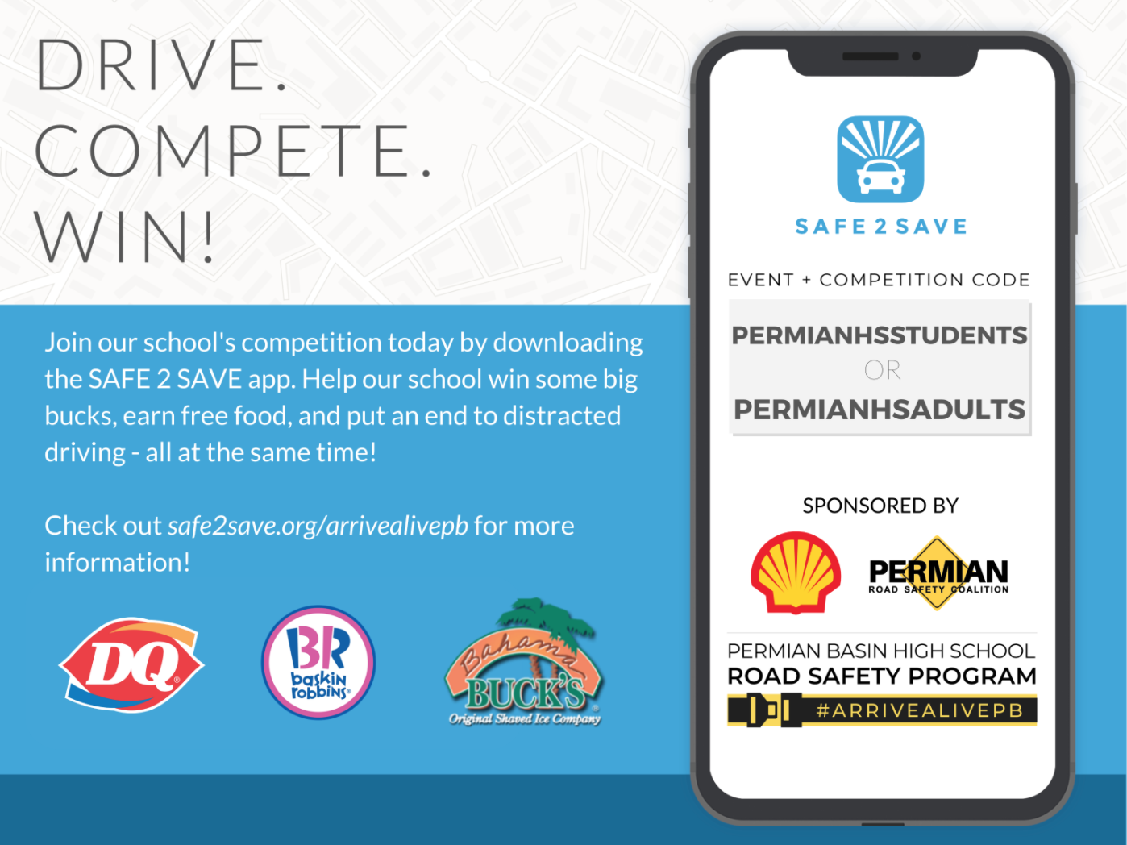
ECISD Codes
Please see below for your schools code. There are two groups per school, one for students and one for teachers + parents.
SCHOOL | STUDENT CODE | PARENTS + TEACHER CODE
Odessa High School | ODESSASTUDENTS | ODESSAADULTS
Permian High School | PERMIANHSSTUDENTS | PERMIANHSADULTS
Notes:
Link them out to each of the resources and have 1 -2 sentences on HOW and WHEN they can utilize each resource
Inviting friends via text through the app - make that point

Slide 8
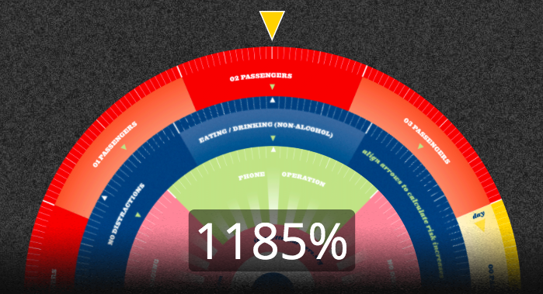
Did you know you are more likely to crash with passengers in the car? That driving in the dark matters? That distractions layer + increase risks?
The probability wheel shows the increased probability of being in a car crash based on the scenario.
Click this link to try it out!

Slide 9
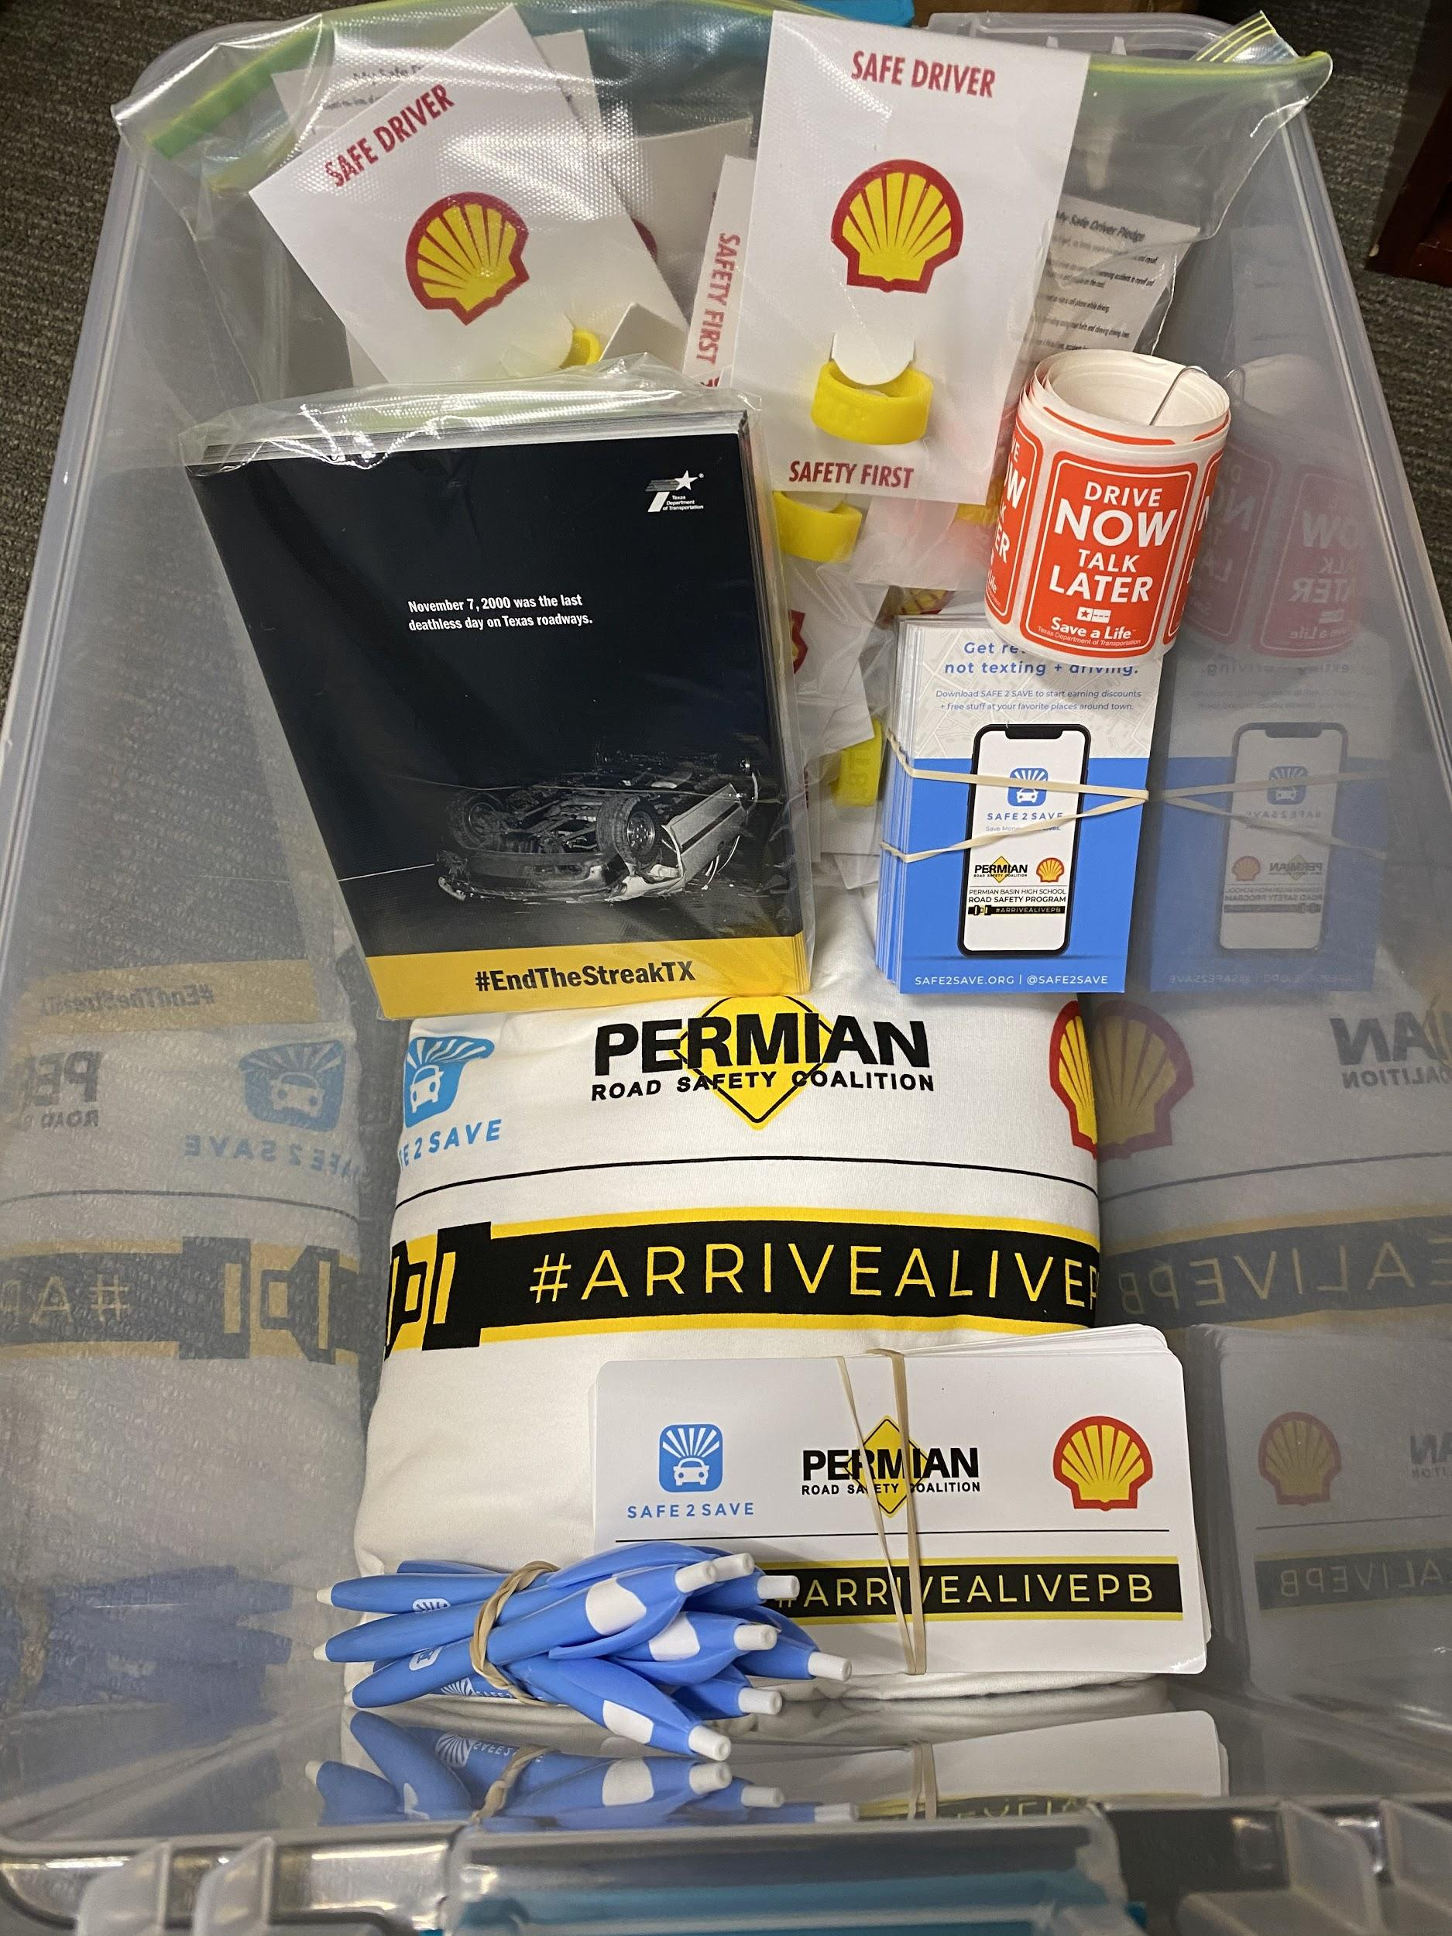
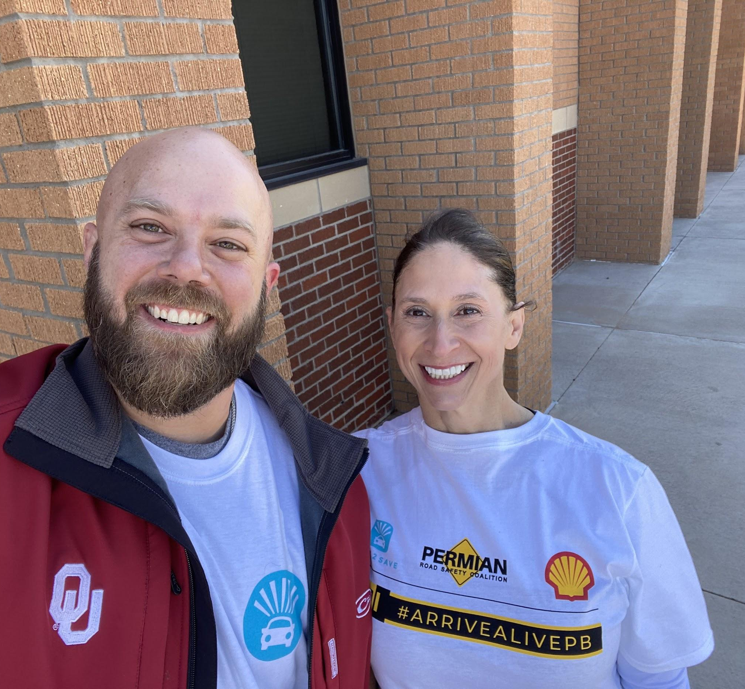
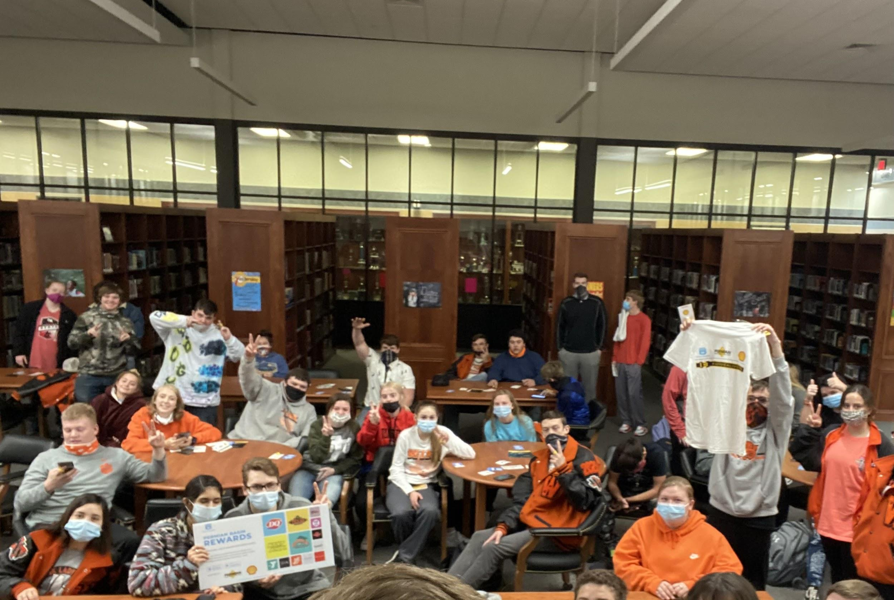
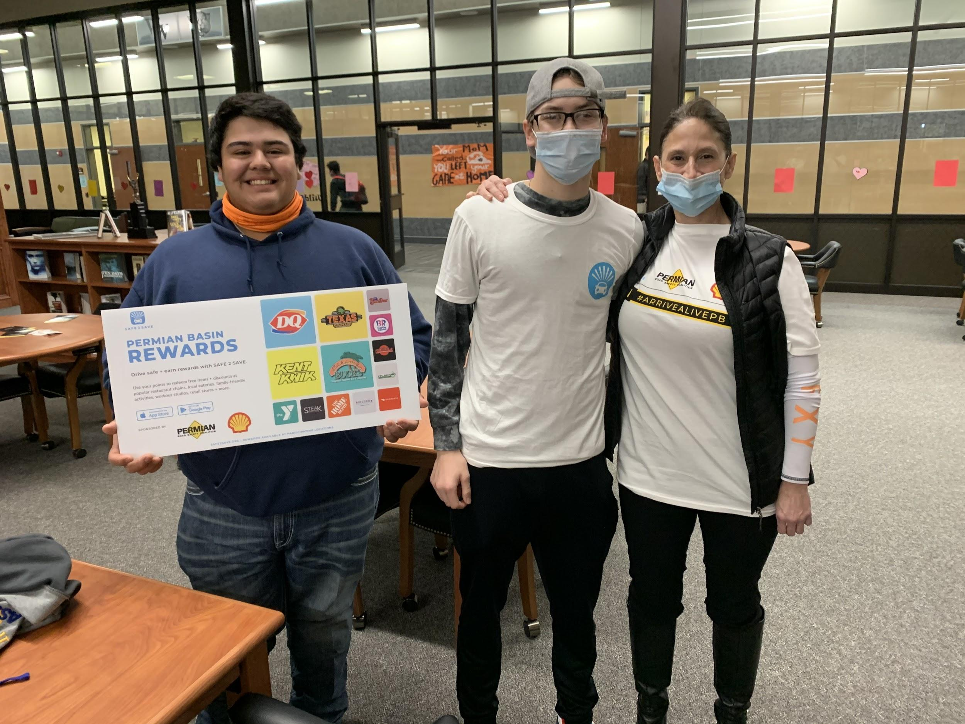
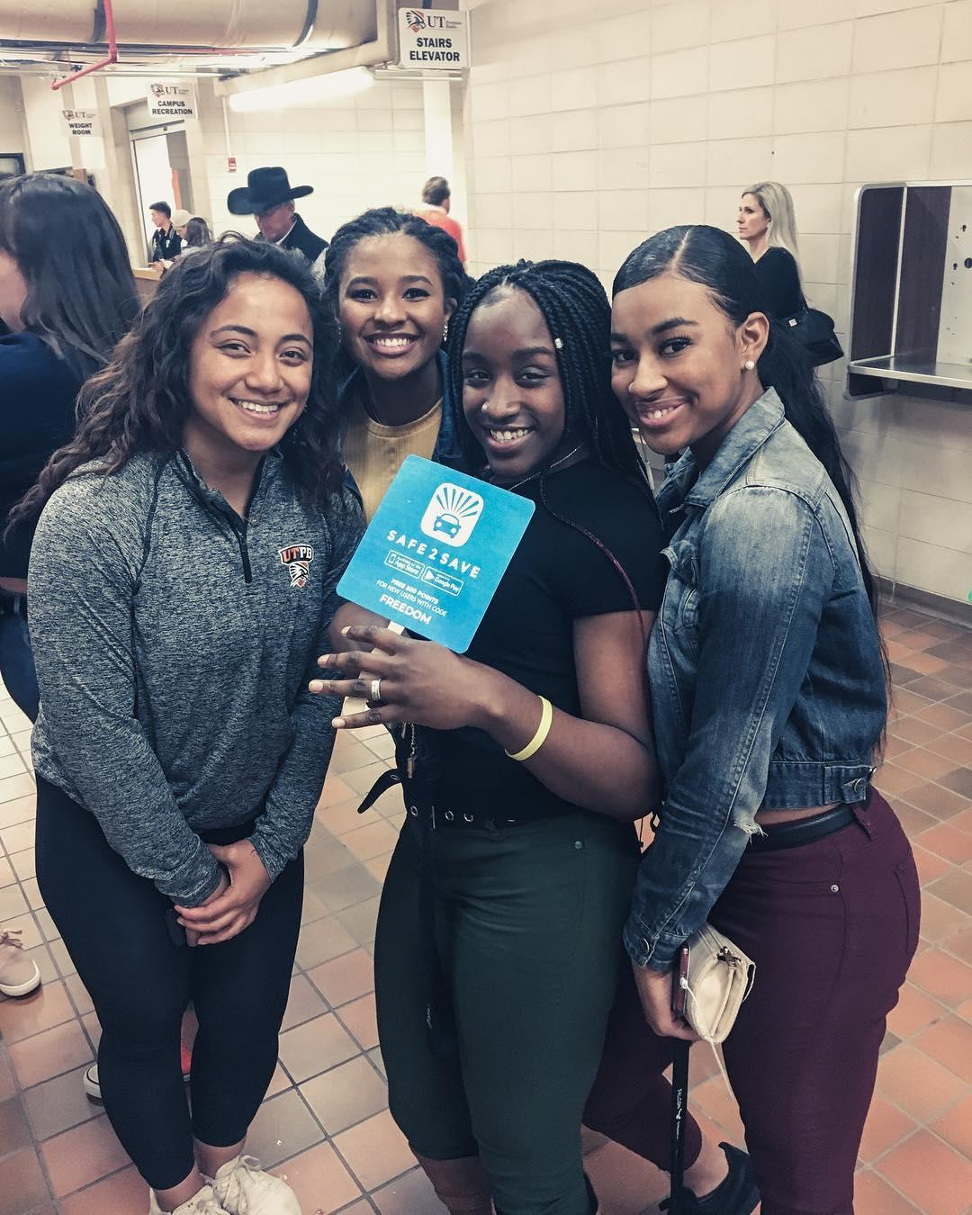
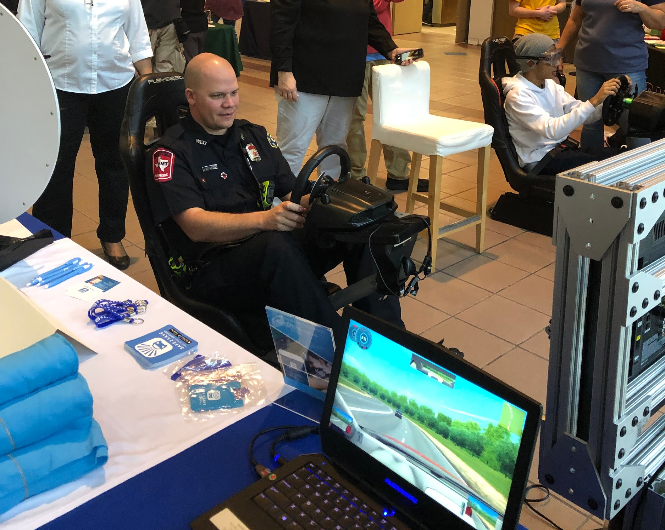
SCHOOL EDUCATION PROJECTS #ARRIVEALIVEPB
Notes:
Schools in the Houston area and sharing about distracted driving, Live Your Dreams and Memorial Hermann being the title sponsor

Slide 10
Video Contest Information
In addition to the safe driving competition, we will be awarding $750 to the student organization that produces the best video about distracted driving and the competition! Share the video on your school’s social media and let us know you did so to be considered. (email meagan@safe2save.org)
The video should be :
Creative
Educational
Energetic
In English and Spanish (props if you do BOTH!)

Slide 11
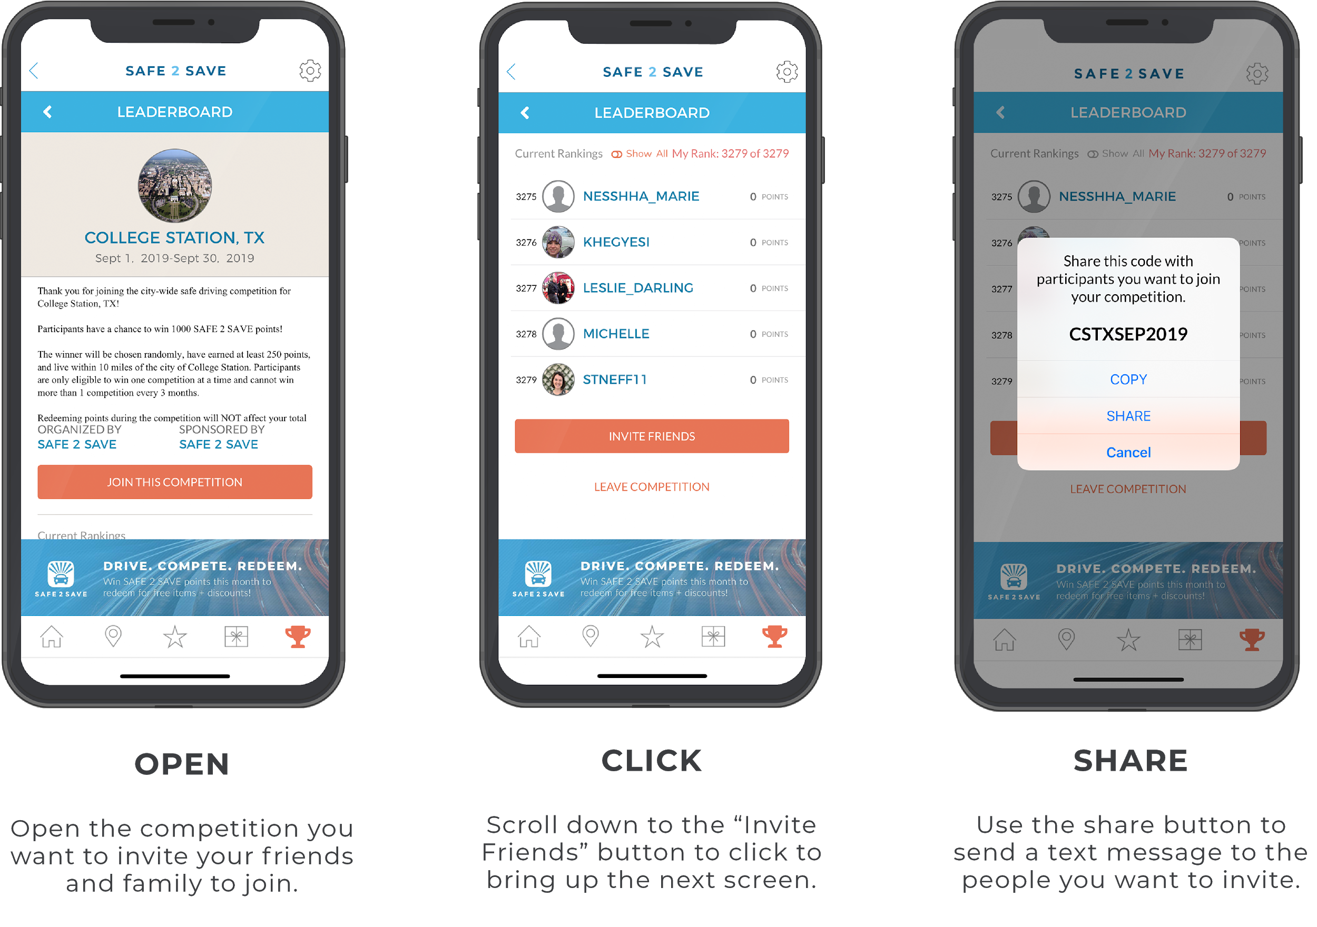
Sharing is Easy!
Follow the simple steps below to invite your friends + family to join! Who will you invite today?

Slide 12
What people in your
COMMUNITY
can you SHARE this with?
HIGH SCHOOL + COLLEGE FRIENDS
AS EVEN THOSE IN OTHER TOWNS CAN USE THIS
PARENTS + RELATIVES
FIRST
RESPONDERS
NEWS: SHARE your STORY of WHY you care
+
BUSINESSES
CHURCH YOUTH GROUP
YOUR SOCIAL MEDIA + TAG @SAFE2SAVE
SOCIAL
ORGANIZATIONS

Slide 13
THESE POSTERS ARE IN EACH SCHOOL + BEING SHARED DIGITALLY TO PARENTS
.

Slide 14
Your School’s Code
Please see below for your schools code. There are two groups per school, one for students and one for teachers + parents.
SCHOOL | STUDENT CODE | PARENTS + TEACHER CODE
Andrews High School | ANDREWSSTUDENTS | ANDREWSADULTS
Kermit High School | KERMITSTUDENTS | KERMITADULTS
Lee High School | LHSSTUDENTS | LHSADULTS
Midland High School | MIDLANDSTUDENTS | MIDLANDADULTS
Monahans High School | MONAHANSSTUDENTS | MONAHANSADULTS
Odessa High School | ODESSASTUDENTS | ODESSAADULTS
Pecos High School | PECOSSTUDENTS | PECOSADULTS
Wink High School | WINKSTUDENTS | WINKADULTS
Permian High School | PERMIANHSSTUDENTS | PERMIANHSADULTS
Notes:
Link them out to each of the resources and have 1 -2 sentences on HOW and WHEN they can utilize each resource
Inviting friends via text through the app - make that point

Slide 15
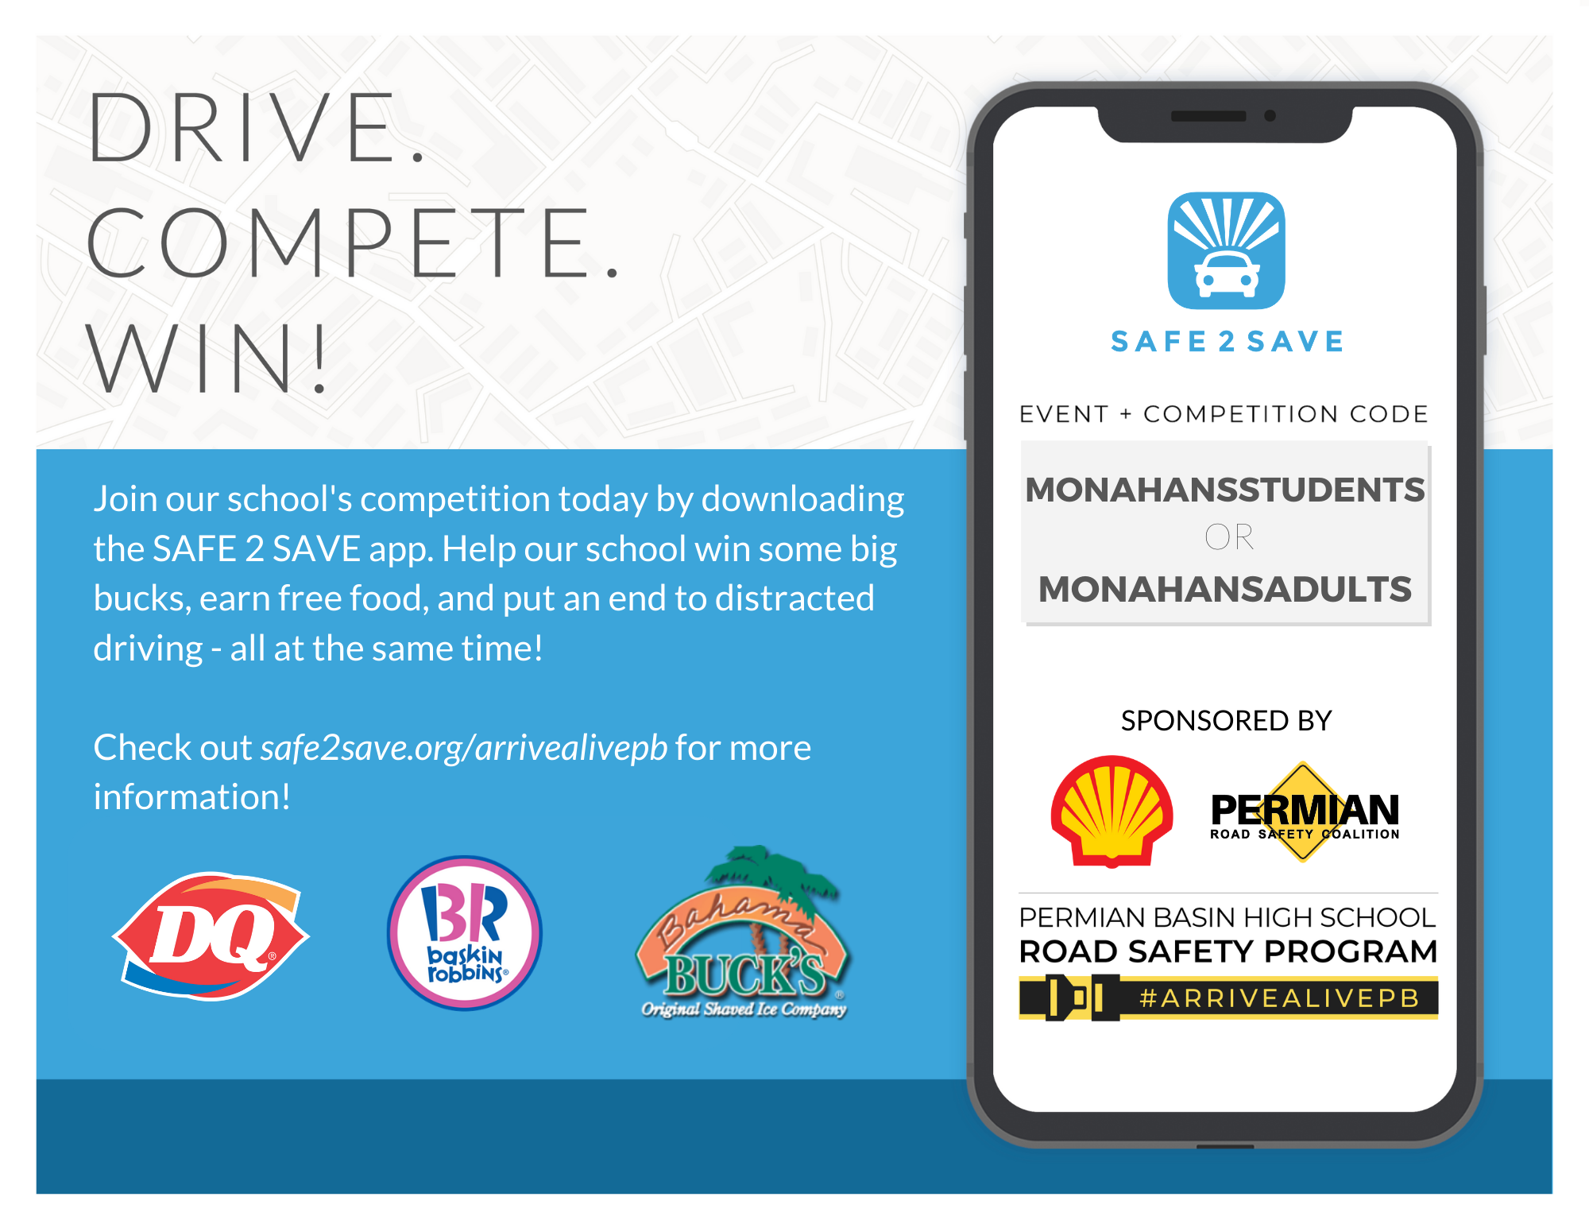
How can you help?! Offer Rewards + Drive people in - Win Win
Share out on Social Media personally + with your org. + tag us: @safe2save
@permianroadsafetycoalition
@shell
Use #ArriveAlivePB
Share Videos out + Identify families to speak out
Tell PARENTS as they can win $$ too
Available in Spanish too!
Tell Companies to sign up with SAFE 2 SAVE PRO
www.safe2save.org/employers

Slide 16
About Our Sponsors
The Permian Road Safety Coalition (PRSC) is based in Midland, Texas and leads a collaborative effort with oil and natural gas operators, oil field service and transportation companies, non-governmental and governmental organizations to improve road safety and reduce the number of traffic-related injuries and deaths in the Permian Basin. Learn more at www.permianroadsafety.org.
Shell companies have operations in more than 70 countries and territories with businesses including oil and gas exploration and production; production and marketing of liquefied natural gas and gas to liquids; manufacturing, marketing, and shipping of oil products and chemicals and renewable energy projects. For further information,visit www.shell.com.

Slide 17
Meagan Kamra
Competitions Coordinator
meagan@safe2save.org
214-477-7808
Learn more at safe2save.org
Notes:
Link them out to each of the resources and have 1 -2 sentences on HOW and WHEN they can utilize each resource
Inviting friends via text through the app - make that point

